Slide 1
Testing Documentation

Slide 2
Testing Documentation
Testing documentation is the documentation of artifacts that are created during or before the testing of a software application.
Documentation reflects the importance of processes for the customer, individual and organization.
Projects which contain all documents have a high level of maturity.
Careful documentation can save the time, efforts and wealth of the organization.

Slide 3
Testing Documentation
There is the necessary reference document, which is prepared by every test engineer before stating the test execution process.
Once the test document is ready, the entire test execution process depends on the test document.
The primary objective for writing a test document is to decrease or eliminate the doubts related to the testing activities.

Slide 4
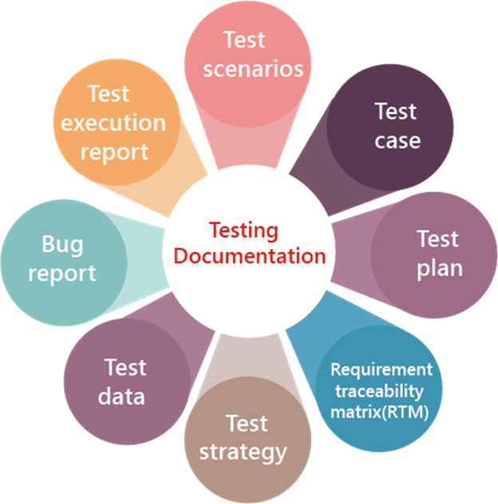
Types of test document
In software testing, we have various types of test document, which are as follows:
Test scenarios
Test case
Test plan
Requirement traceability matrix(RTM)
Test strategy
Test data
Bug report
Test execution report

Slide 5
Test Scenarios
The test scenario is a detailed document of test cases that cover end to end functionality of a software application in liner statements.
The liner statement is considered as a scenario.
The test scenario is a high-level classification of testable requirements.
These requirements are grouped on the basis of the functionality of a module and obtained from the use cases.
In the test scenario, there is a detailed testing process due to many associated test cases.
Before performing the test scenario, the tester has to consider the test cases for each scenario.

Slide 6
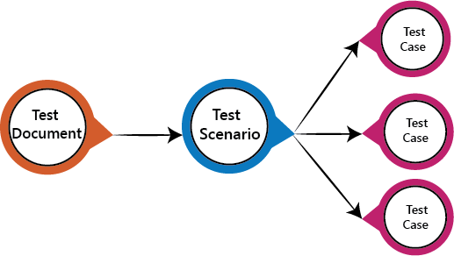
Test Scenarios
In the test scenario, testers need to put themselves in the place of the user because they test the software application under the user's point of view.
Preparation of scenarios is the most critical part, and it is necessary to seek advice or help from customers, stakeholders or developers to prepare the scenario.

Slide 7
How to write Test Scenarios
Read the requirement document such as BRS (Business Requirement Specification), SRS (System Requirement Specification) and FRS (Functional Requirement Specification) of the software which is under the test.
Determine all technical aspects and objectives for each requirement.
Find all the possible ways by which the user can operate the software.
Ascertain all the possible scenario due to which system can be misused and also detect the users who can be hackers.

Slide 8
How to write Test Scenarios
After reading the requirement document and completion of the scheduled analysis make a list of various test scenarios to verify each function of the software.
Once you listed all the possible test scenarios, create a traceability matrix to find out whether each and every requirement has a corresponding test scenario or not.
Supervisor of the project reviews all scenarios. Later, they are evaluated by other stakeholders of the project.

Slide 9
Features of Test Scenario
The test scenario is a liner statement that guides testers for the testing sequence.
Test scenario reduces the complexity and repetition of the product.
Test scenario means talking and thinking about tests in detail but write them in liner statements.
It is a thread of operations.
Test scenario becomes more important when the tester does not have enough time to write test cases, and team members agree with a detailed liner scenario.
The test scenario is a time saver activity.
It provides easy maintenance because the addition and modification of test scenarios are easy and independent.

Slide 10
Example of Test scenarios
Test scenarios on the Login module
Enter the valid login details (Username, password), and check that the home page is displayed.
Enter the invalid Username and password and check for the home page.
Leave Username and password blank, and check for the error message displayed.
Enter the valid Login, and click on the cancel, and check for the fields reset.
Enter invalid Login, more than three times, and check that account blocked.
Enter valid Login, and check that the Username is displayed on the home screen.

Slide 11
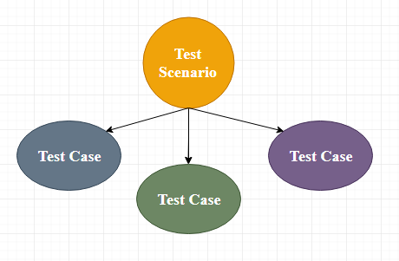
Test Case
The test case is defined as a group of conditions under which a tester determines whether a software application is working as per the customer's requirements or not.
Test case designing includes preconditions, case name, input conditions, and expected result.
A test case is a first level action and derived from test scenarios.

Slide 12
Test Case
It is an in-details document that contains all possible inputs (positive as well as negative) and the navigation steps, which are used for the test execution process.
Writing of test cases is a one-time attempt that can be used in the future at the time of regression testing.
Test case gives detailed information about testing strategy, testing process, preconditions, and expected output.
These are executed during the testing process to check whether the software application is performing the task for that it was developed or not.

Slide 13
Test Case
Test case helps the tester in defect reporting by linking defect with test case ID.
Detailed test case documentation works as a full proof guard for the testing team because if developer missed something, then it can be caught during execution of these full-proof test cases.
To write the test case, we must have the requirements to derive the inputs, and the test scenarios must be written so that we do not miss out on any features for testing.
Then we should have the test case template to maintain the uniformity, or every test engineer follows the same approach to prepare the test document.

Slide 14
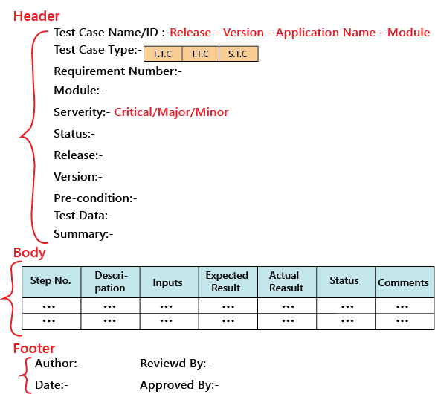
Test case template

Slide 15
Types of test cases
Function test cases
Integration test cases
System test cases

Slide 16
Test Plan
A test plan is a detailed document which describes software testing areas and activities.
It outlines the test strategy, objectives, test schedule, required resources (human resources, software, and hardware), test estimation and test deliverables.
The test plan is a base of every software's testing.
It is the most crucial activity which ensures availability of all the lists of planned activities in an appropriate sequence.
The test plan is a template for conducting software testing activities as a defined process

Slide 17
How to write a Test Plan
First, analyze product structure and architecture.
Now design the test strategy.
Define all the test objectives.
Define the testing area.
Define all the useable resources.
Schedule all activities in an appropriate manner.
Determine all the Test Deliverables.

Slide 18
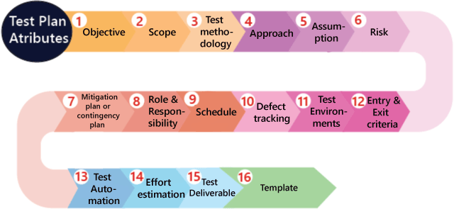
Test plan components or attributes

Slide 19
Traceability Matrix
Traceability matrix is a table type document that is used in the development of software application to trace requirements.
It can be used for both forward (from Requirements to Design or Coding) and backward (from Coding to Requirements) tracing.
It is also known as Requirement Traceability Matrix (RTM) or Cross Reference Matrix (CRM).

Slide 20
Traceability Matrix
It is prepared before the test execution process to make sure that every requirement is covered in the form of a Test case so that we don't miss out any testing.
In the RTM document, we map all the requirements and corresponding test cases to ensure that we have written all the test cases for each condition.

Slide 21
Traceability Matrix
This document is designed to make sure that each requirement has a test case, and the test case is written based on business needs, which are given by the client.
It will be performed with the help of the test cases if any requirement is missing, which means that the test case is not written for a particular need, and that specific requirement is not tested because it may have some bugs.
The traceability is written to make sure that the entire requirement is covered.

Slide 22
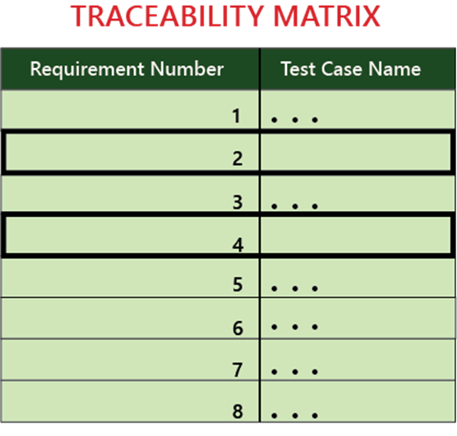
Traceability Matrix
Generally, this is like a worksheet document, which contains a table, but there are also many user-defined templates for the traceability matrix.
Each requirement in the traceability matrix is connected with its respective test case so that tests can be carried out sequentially according to specific requirements.

Slide 23
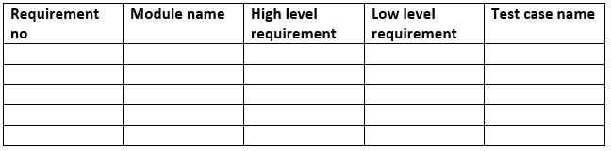
RTM Template

Slide 24
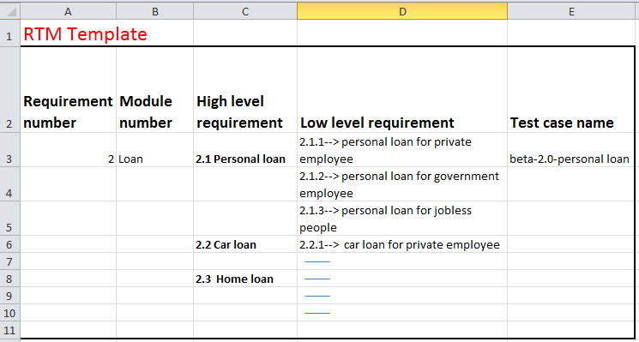
Example of RTM template

Slide 25
Goals of Traceability Matrix
It helps in tracing the documents that are developed during various phases of SDLC.
It ensures that the software completely meets the customer's requirements.
It helps in detecting the root cause of any bug.

Slide 26
Test strategy
The test strategy is a high-level document, which is used to verify the test types (levels) to be executed for the product and also describe that what kind of technique has to be used and which module is going to be tested.
The Project Manager can approve it.
It includes the multiple components such as documentation formats, objective, test processes, scope, and customer communication strategy, etc. we cannot modify the test strategy.

Slide 27
Test data
It is data that occurs before the test is executed.
It is mainly used when we are implementing the test case.
Mostly, we will have the test data in the Excel sheet format and entered manually while performing the test case.
The test data can be used to check the expected result, which means that when the test data is entered, the expected outcome will meet the actual result and also check the application performance by entering the in-correct input data.

Slide 28
Bug report
The bug report is a document where we maintain a summary of all the bugs which occurred during the testing process.
This is a crucial document for both the developers and test engineers because, with the help of bug reports, they can easily track the defects, report the bug, change the status of bugs which are fixed successfully, and also avoid their repetition in further process.

Slide 29
Test execution report
It is the document prepared by test leads after the entire testing execution process is completed.
The test summary report defines the constancy of the product, and it contains information like the modules, the number of written test cases, executed, pass, fail, and their percentage.
And each module has a separate spreadsheet of their respective module.

